Slide 1
OPERATING SYSTEM

Slide 2
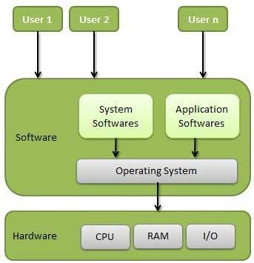
WHAT IS OPERATING SYSTEM?
An operating system, or "OS," is software that communicates with the hardware and allows other programs to run. It is comprised of system software, or the fundamental files your computer needs to bootup and function.

Slide 3
Types of operating system
There are Mainly 4 Types of operating systems
Time-sharing operating systems
Distributed operating System
Network operating System
Real Time operating System

Slide 4
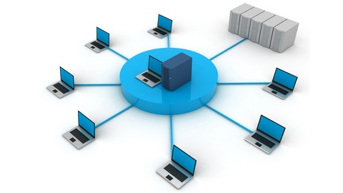
Time-sharing operating systems
Time-sharing is a technique which enables many people, located
various terminals,to use a particular computer system at the same time. Time-sharing or multitasking is a logical extension of multiprogramming.

Slide 5
Advantages and dis advantages
Advantages:-
Provides the advantage of quick response.
Avoids duplication of software.
Reduces CPU idle time.
Dis-Advantages:-
Problem of reliability.
Question of security and integrity of user programs and data.
Problem of data communication.

Slide 6
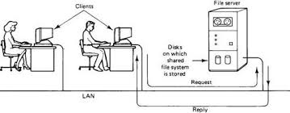
Distributed operating System
Distributed systems use multiple central processors to serve multiple real-time applications and multiple users.
The processors communicate with one another through various communication lines (such as high-speed buses or telephone lines). These are referred as loosely coupled systems or distributed systems.

Slide 7
Advantages of Distributed Operating System
Speedup the exchange of data with one another via electronic mail.
If one site fails in a distributed system, the remaining sites can potentially continue operating.
Better service to the customers.
Reduction of the load on the host computer.
Reduction of delays in data processing.

Slide 8
NETWORK OPERATING SYSTEM
A specialized operating system for a network device such as a router, switch or firewall.
An operating system oriented to computer networking, to allow shared file and printer access among multiple computers in a network, to enable the sharing of data, users, groups, security, applications, and other networking functions, typically over a local area network (LAN), or private network . This sense is now largely historical, as common operating systems generally now have such features included.

Slide 9
There are two types of network operating system.
Peer to peer network
Client and server network
Peer to peer network:-
This is a type of network in which all computers are connected to each other.
It is inexpensive to setup.
Files are placed on any computer and can be accessed by any other computer in the network.
This type of network is best for small or medium size organization.

Slide 10
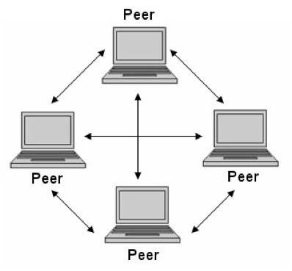
Advantages of peer to peer network:-
It is easy to configure
It is not expensive to setup
Disadvantages of peer to peer network:-
No control over all the computers i.e. decentralized
Security problem
Client and server network
Client and server network:-

Slide 11
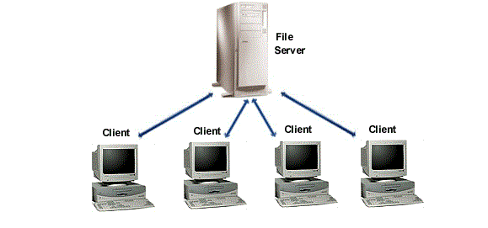
client and server network
This is type of network in which there is a server that is attached to client computer. So one computer is behaving as a center server controlling and managing other computers.

Slide 12
Advantages of client and server network:-
Security is well managed in these systems
New resources can be easily added and removed to these networks
New technology can be put in without any problem
Server can be accessed remotely also
Disadvantages of client and server network:-
It is expensive to setup
Maintenance of these systems require more staff
All computers are dependent on server. If server crashes then all computers effected

Slide 13
REAL time operating system
A real-time operating system is a multitasking operating system designed for real-time applications. Such applications include embedded systems, industrial robots, scientific research equipment and others.
Advantages of real-time operating system :
Maximum Consumption of the system
Task Shifting
Focus on Application

Slide 14
Disadvantages of Real Time Operating System:
Limited Tasks
Use heavy system resources
Low multi-tasking
Complex Algorithms
Thread Priority

